Slide 1

Twitter
Sentiment Analysis
By: Jennifer Belfeld,
Emerald Pham,
Garett Ruping,
Lijian Yu,
Anson Zheng

Slide 2
What our project is about
garett
Classify tweets
Notes:
garett

Slide 3

Dataset
Sentiment 140 from Kaggle
1,600,000 tweets
800,000 positive tweets
800,000 negative tweets
Scraping tweets off of Elon twitter
100 tweets from Elon Musk
Each labeled by the team
Notes:
Anson

Slide 4
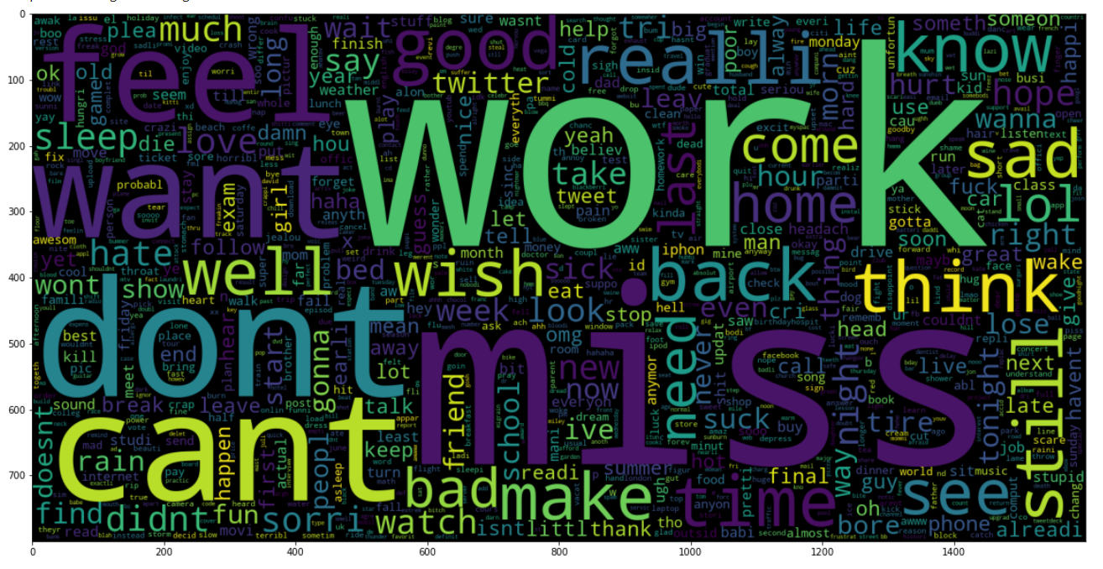
Word Cloud for Negative Tweets

Slide 5
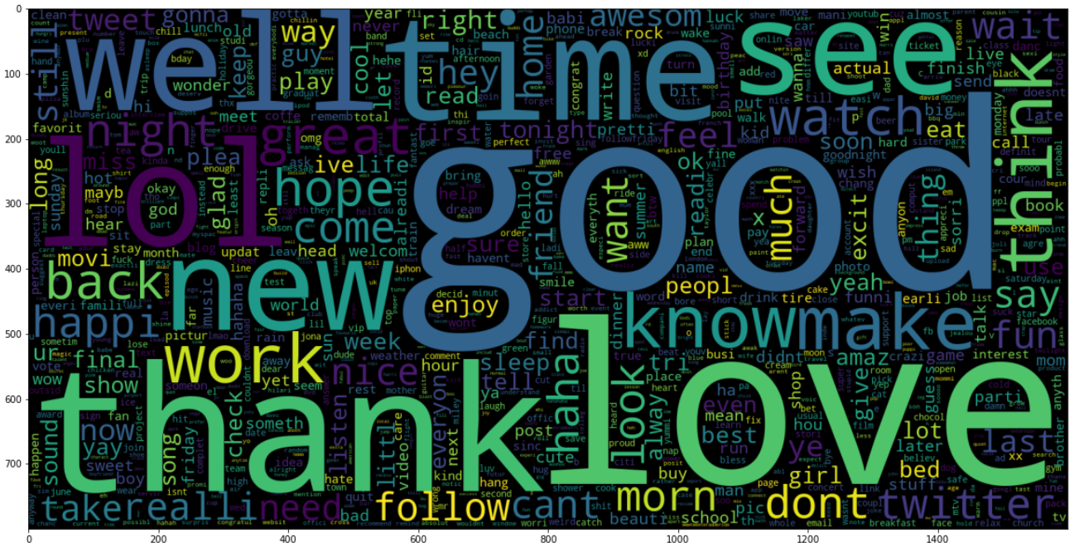
Word Cloud for Positive Tweets

Slide 6
Preprocessing
Garett emerald

Slide 7
All models table with accuracy
jennifer

Slide 8
Info about ensemble, all combinations
emerald

Slide 9
Best overall model with demo
emerald
Demo of best model, overall accuracy on test dataset, confusion matrix
DEMO: SHOW REAL TWEET FROM DATASET AND/OR NOT IN DATASET, AND WHAT IT PREDICTS IT AS,
SHOW REAL ELON MUSK TWEETS WITH WHAT WE CLASSIFIED IT AS

Slide 10
Deliverables
Git hub link
Website link

